Slide 1

CS 380 PackMon
Tony Coraggio – Hunter Lawrence – Devin Irby

Slide 2
Project Description
PackMon Monster Battler
Our project is a working game where the user controls a character who will battle an onslaught of enemies. The project is based on the battle system of Pokemon, where the user can choose specific attacks or actions to advance further in the game. In our project, we will give the user two basic commands: Attack and Heal. These will all affect how the user is able to play the game.

Slide 3
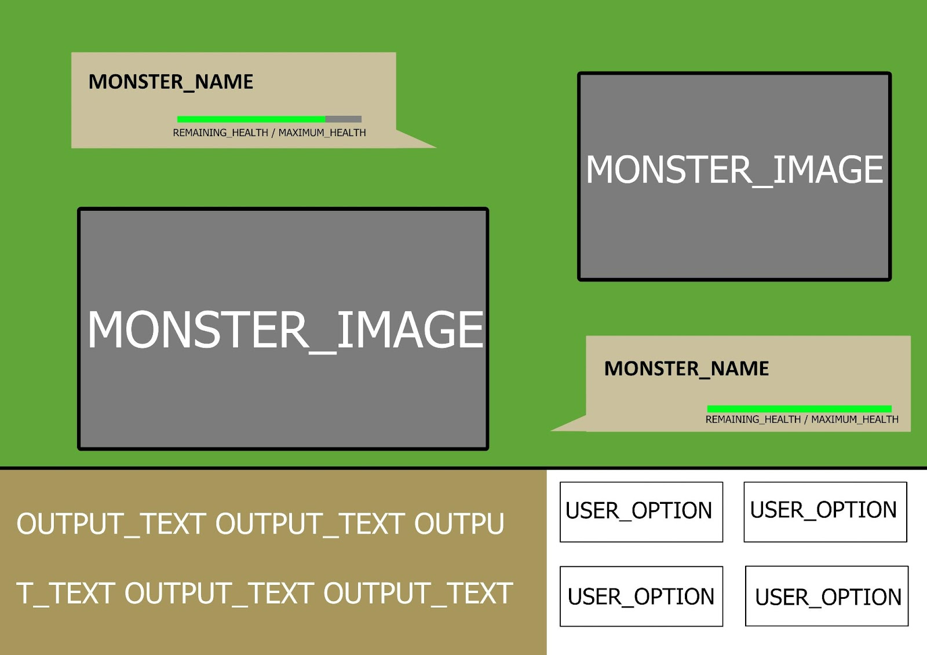
Main Battle Window
Ideas:
Generate user commands
Summon random monster
Display feedback in text field
Update health information after each turn
Make system safe

Slide 4
Resources
Created using primarily Java
GUI developed using Eclipse WindowBuilder
Images created using “Krita” drawing software
Data collection using MySQL Workbench
ERD created using SQL

Slide 5
Demo!

